Slide 1
Customer Segmentation Using RFM Analysis
By-Arjun Raghav

Slide 2
Objective :
The primary objective is to maximizing the secondary sales based on customer’s behavior in the last FY 2022-23.
How to do it :
studying our customers behavior based on sale trend analysis
Segmenting each customer into unique behavioral classes using behavioral modelling (RFM model).

Slide 3
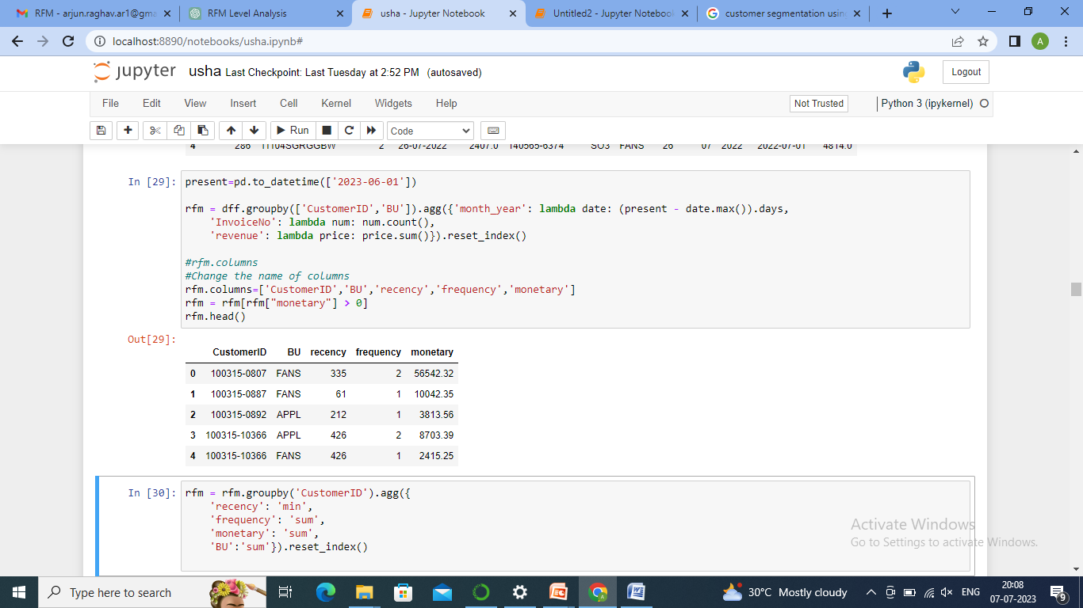
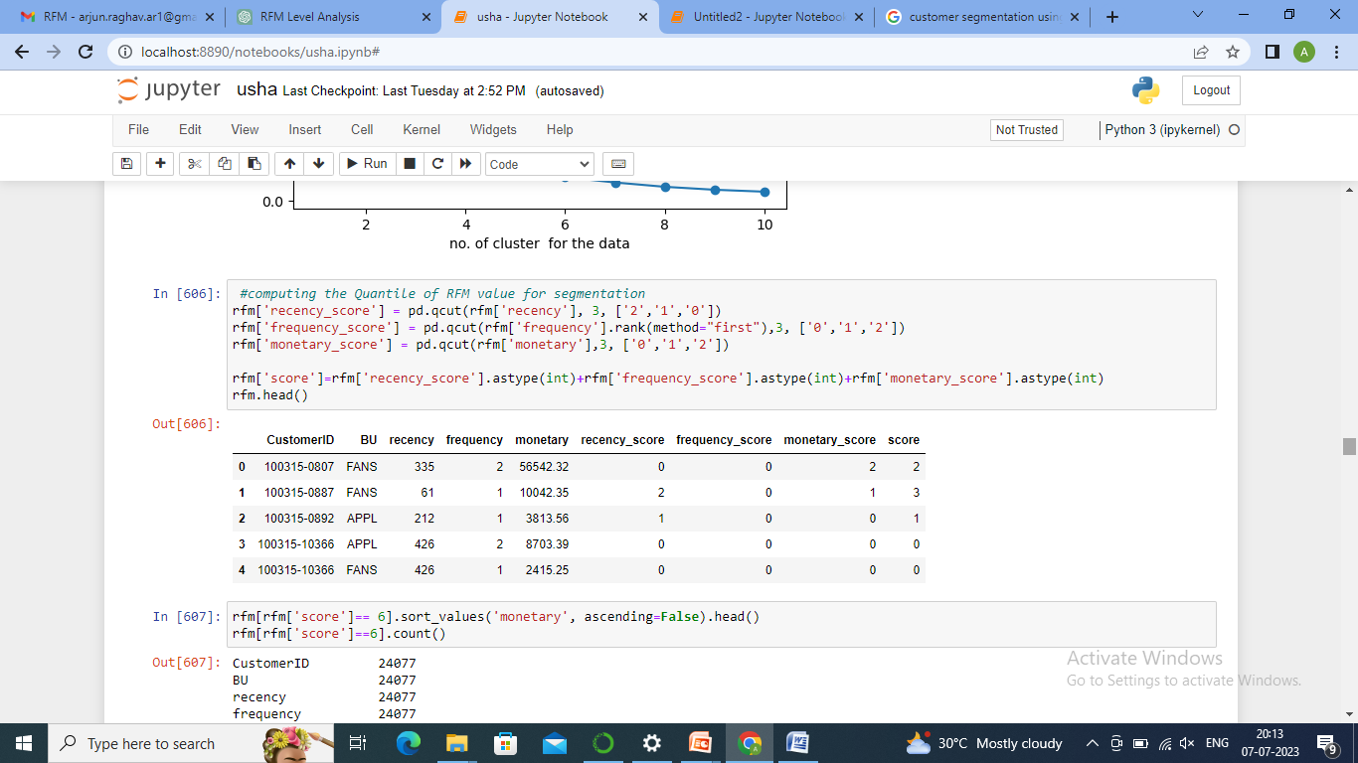
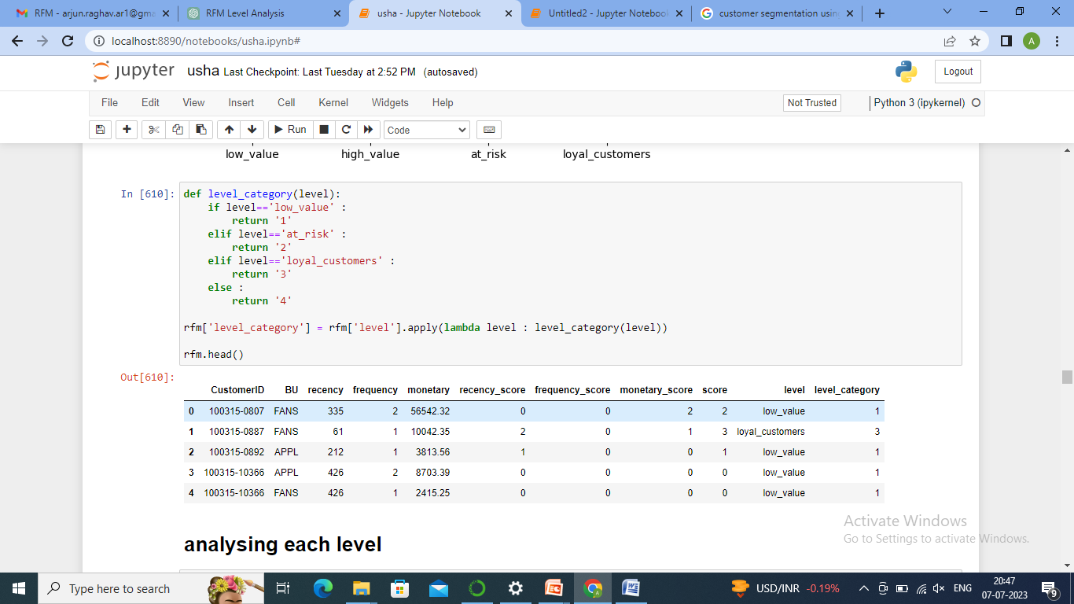
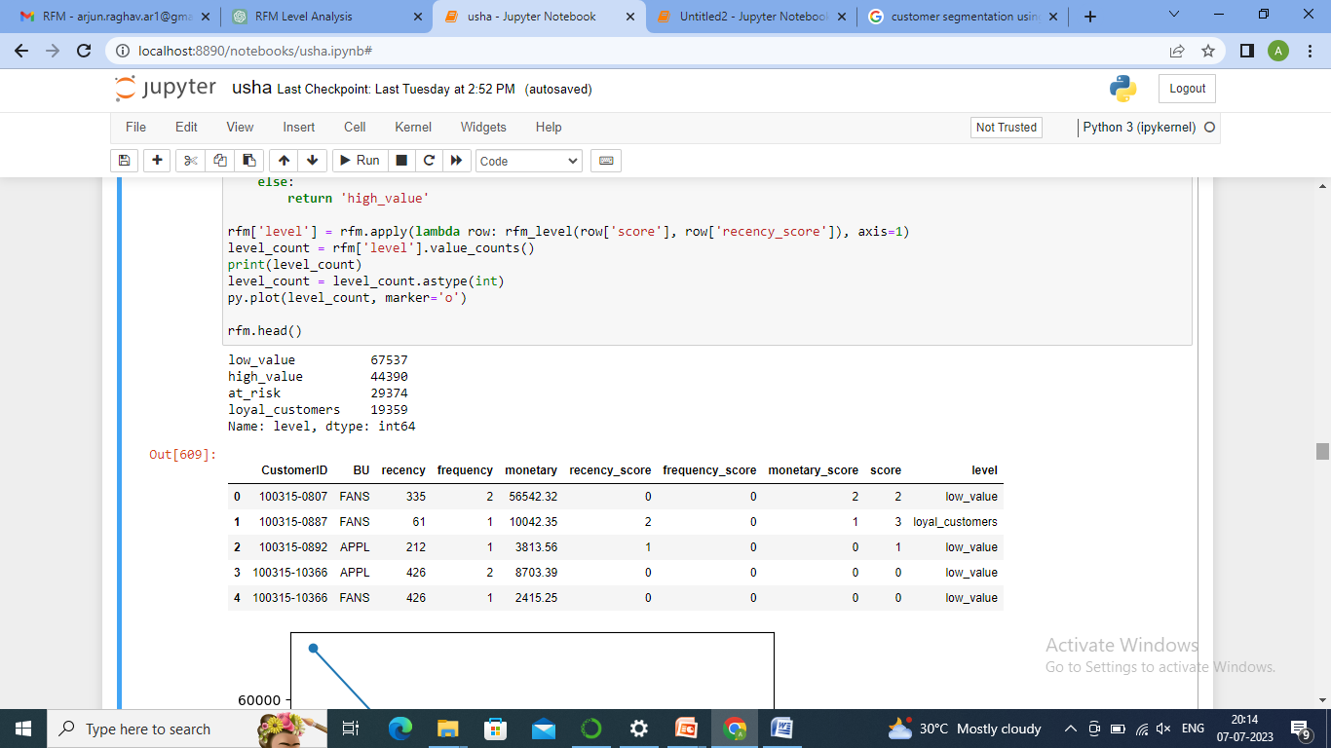
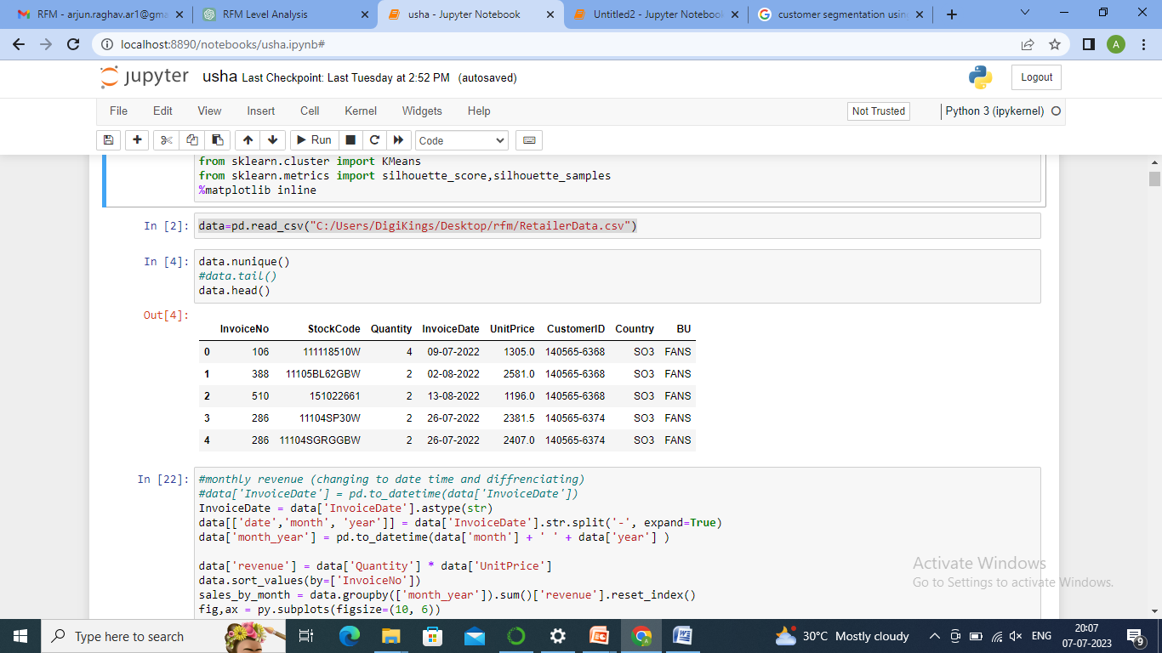

Slide 7
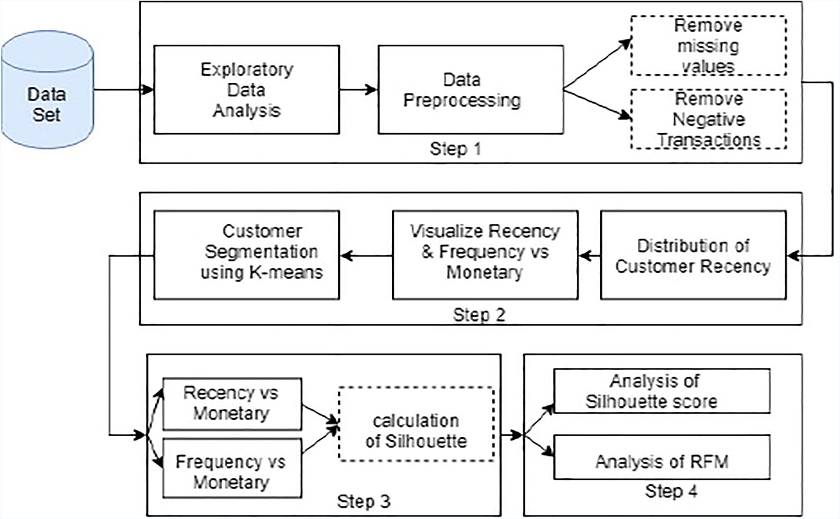
Workflow of the model

Slide 8
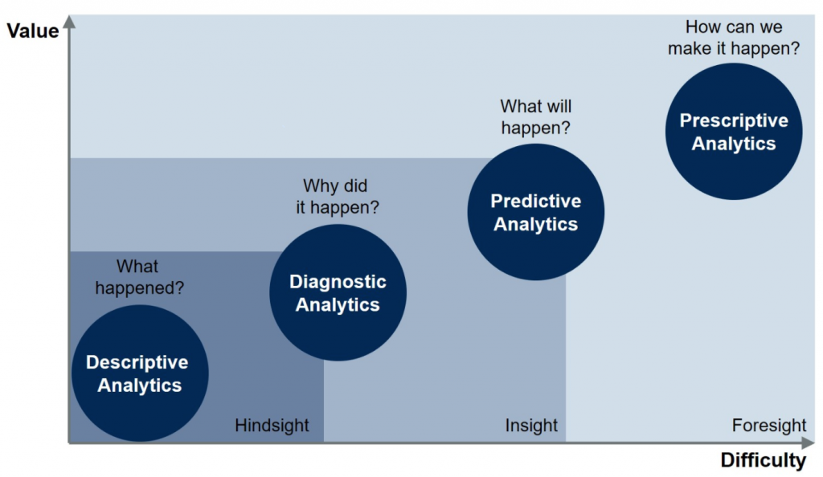
Sale trend Analysis
First we will analyze how our revenue trends against different factors that can impact the sale
Prescriptions for Customer Behavior Model
Customer Behavior Model-RFM

Slide 9
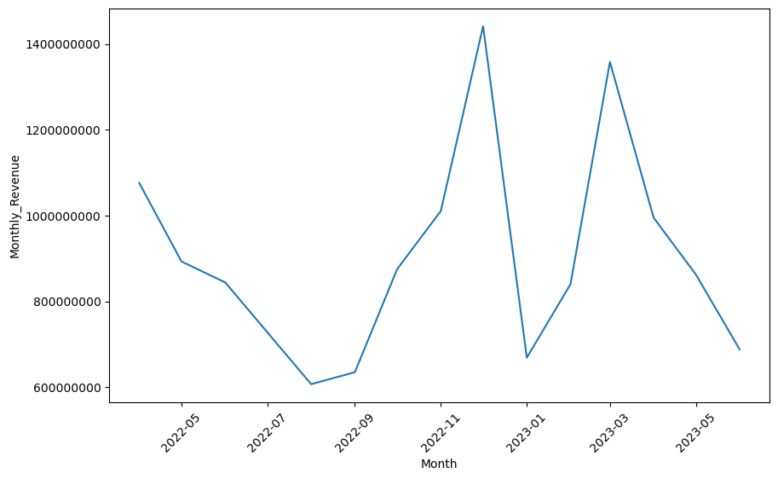
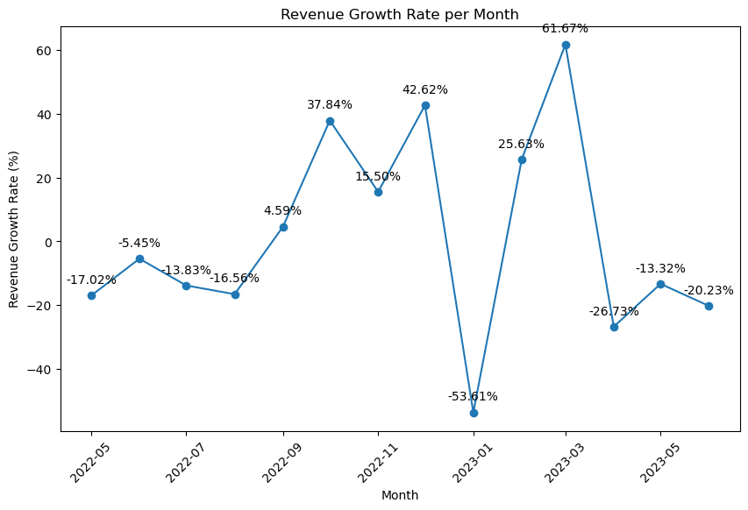
REVENUE AND REVENUE GROWTH RATE GRAPH
Revenue
REVENUE GROWTH RATE
We can see that revenue is decreasing in 2022-MAY,2023-APR while revenue growth rate is increasing
We can see that revenue is increasing in 2022-OCT while revenue growth rate is decreasing
revenue dropped significantly in 2022-JUNE -2022-AUGUST but revenue growth rate didn’t dropped as such.

Slide 10
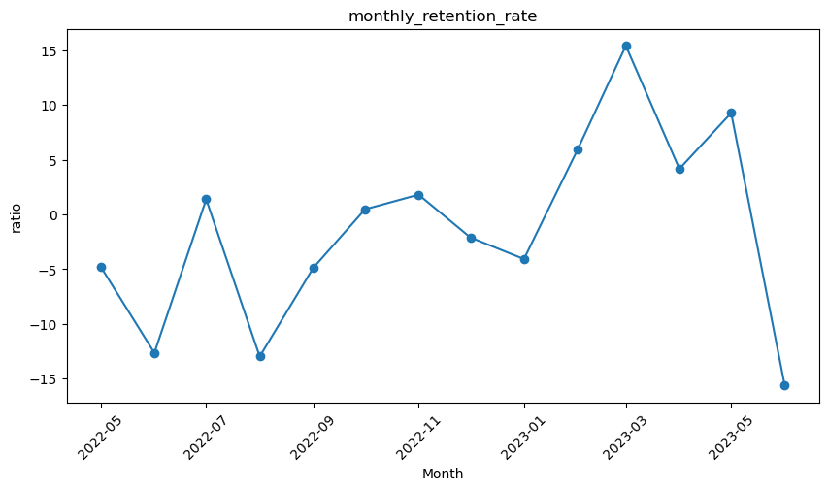
REVENUE AND RETENTION RATE
Revenue
Retention Rate
In 2022-JUNE and 2023-APR revenue decreased but retention rate went up
In 2022-NOV revenue increased but retention rate went down
From 2022-SEPT – 2022-DEC revenue increased to its peak but retention rate was not that significant
In 2022-DEC revenue falls drastically but retention rate didn’t fall to that extent

Slide 11
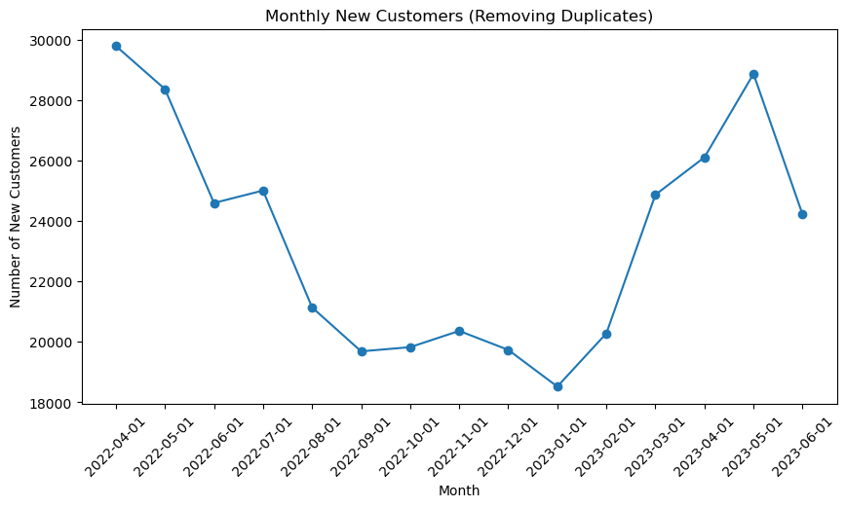
REVENUE AND NEW CUSTOMERS
Revenue
New Customer
In new customers graphs trend line there is an significant decrease in the 2022-MAY but the downfall is not that significant in revenue
from 2022-AUG - 2022-DEC there’s no net change in the new customers graph but revenue was generated the most in this period.
Our new customers graph goes upwards in 2023-MAR – 2023-MAY but revenue graph shows a downfall .
New customers visited max in (2023-JAN - 2023-MAY).

Slide 12
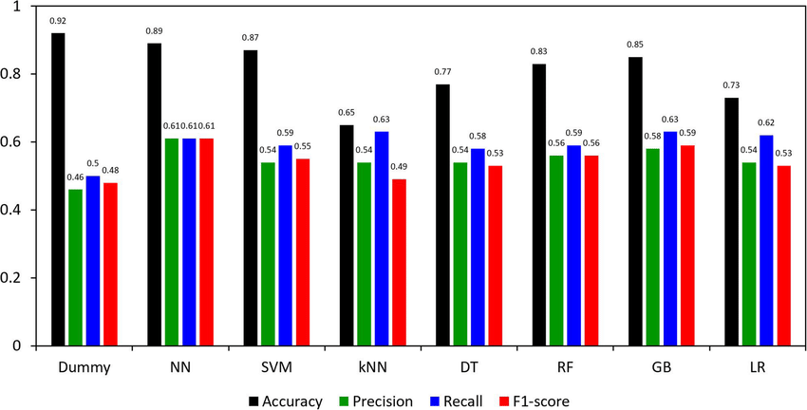
Results obtained when different algo’s are used to test the customer data

Slide 13
CUSTOMER BEHAVIOURAL MODEL(RFM)
RFM analysis is a popular technique used in marketing and customer relationship management to segment and understand customers based on their transactional behavior. RFM stands for Recency, Frequency, and Monetary Value, which are three key dimensions used to categorize customers

Slide 14
Recency (R): Recency refers to how recently a customer has made a purchase or interacted with the business. It is a measure of the time elapsed since the customer's last transaction. Customers who have made a purchase more recently are often considered more engaged or active compared to those who haven't made a purchase in a long time. Recency values are typically measured in terms of days, weeks, or months.

Slide 15
Frequency (F): Frequency represents how often a customer makes purchases or interacts with the business within a given period. It measures the number of transactions or interactions made by the customer over a specific timeframe. Customers with higher frequency values are considered more loyal or engaged with the business. Frequency values can range from low (few transactions) to high (frequent transactions)

Slide 16
Monetary Value (M): Monetary value reflects the total amount of money spent by the customer on purchases or transactions. It measures the cumulative value of the customer's transactions over a certain period. Customers who spend more money on their purchases are often considered more valuable or profitable to the business. Monetary value can vary widely among customers, with some being high-value spenders and others being low-value spenders.

Slide 17
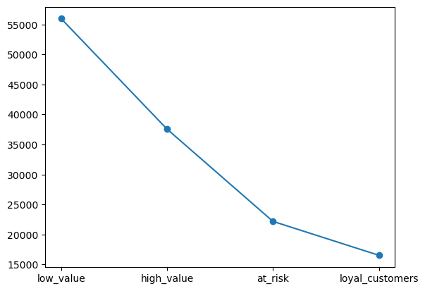
CUSTOMER CATEGORIZATION
We got a total score and based on that we further categorized our customers as-
High value customer- These are doing excellent in their Recency Frequency as well as in monetary vales
Potential/loyal customers- customers with best recency values but low frequency and monetary value
At-Risk customers- These customers have good monetary and frequency values but they have poor recency
Low value/Lost customers- These customers have either gone extinct or They have very poor Recency, Frequency, Monetary values.
Customer Category | Count
High value customers | 37566
Loyal customers | 16514
At-Risk customers | 22173
Low value/Lost customers | 55992
Total= | 132245
Fan | Appl | Sm
22343 | 19259 | 2788
10187 | 8302 | 870
13205 | 14322 | 1847
32136 | 32055 | 3346
77871 | 73938 | 8851

Slide 18
Overall scores
index | Customer-ID | Recency score | frequency score | monetary score | score | category
1 | 100315-11438 | 1 | 2 | 2 | 5 | High value
2 | 100315-5865 | 2 | 2 | 2 | 6 | High value
3 | 100315-10999 | 2 | 1 | 1 | 4 | Loyal customers
4 | 100315-0887 | 2 | 0 | 1 | 3 | Loyal customers
5 | 100315-10977 | 0 | 2 | 2 | 4 | At-risk
6 | 100315-10982 | 1 | 1 | 1 | 3 | At-risk
7 | 100315-5397 | 0 | 0 | 0 | 0 | Low value/Lost
8 | 100315-0892 | 1 | 0 | 0 | 1 | Low value/Lost

Slide 19
In the previous table the overall scores i.e combined scores of the customers (fans,appl,sewing machine) is depicted while in the next tables customers are separated in terms of purchased product
We can see that there are cases when a customer is high value customer according to the overall scores table but potential customer in fans table and high value customer in appl. Table
This helps to further understand the customer more on the basis of purchased product

Slide 20
Fans Scores
index | Customer-ID | Recency score | frequency score | monetary score | score | category
1 | 100315-6968 | 1 | 2 | 2 | 5 | High value
2 | 100315-7019 | 2 | 2 | 2 | 6 | High value
3 | 100315-0887 | 2 | 0 | 1 | 3 | Loyal customers
4 | 100315-10999 | 2 | 1 | 1 | 4 | Loyal customers
5 | 100315-10977 | 0 | 2 | 2 | 4 | At-risk
6 | 100315-10982 | 1 | 1 | 1 | 3 | At-risk
7 | 100315-10367 | 0 | 0 | 0 | 0 | Low value/Lost
8 | 100315-10381 | 0 | 1 | 1 | 2 | Low value/Lost

Slide 21
Appliance Scores
index | Customer-ID | Recency score | frequency score | monetary score | score | category
1 | 100315-4915 | 1 | 2 | 2 | 5 | High value
2 | 100315-5865 | 2 | 2 | 2 | 6 | High value
3 | 100315-7129 | 2 | 0 | 1 | 3 | Loyal customers
4 | 100319-0705 | 2 | 0 | 2 | 4 | Loyal customers
5 | 100315-10503 | 1 | 1 | 1 | 3 | At-risk
6 | 100315-11331 | 0 | 1 | 2 | 3 | At-risk
7 | 100315-0892 | 1 | 0 | 0 | 1 | Low value/Lost
8 | 100315-10366 | 0 | 0 | 0 | 0 | Low value/Lost

Slide 22
Sewing Machine Scores
index | Customer-ID | Recency score | frequency score | monetary score | score | category
1 | 100491-0901 | 2 | 2 | 2 | 6 | High value
2 | 100491-0926 | 2 | 2 | 2 | 6 | High value
3 | 100491-3583 | 2 | 0 | 2 | 4 | Loyal customers
4 | 100491-5941 | 2 | 1 | 1 | 4 | Loyal customers
5 | 100491-1156 | 1 | 1 | 1 | 3 | At-risk
6 | 100491-1159 | 1 | 1 | 2 | 4 | At-risk
7 | 100485-0724 | 0 | 0 | 0 | 0 | Low value/Lost
8 | 100485-0725 | 1 | 0 | 0 | 1 | Low value/Lost

Slide 23
How to draw prescriptions ?
Understand Customer Needs and Preferences: Conduct thorough market research, surveys, and customer feedback analysis to gain insights into customers' needs, preferences, and pain points. Use this information to tailor products, services, and experiences to meet customer expectations effectively.
Provide Personalized Communication: Implement a personalized communication strategy that engages customers on an individual level. Utilize customer data and segmentation techniques (like RFM analysis) to deliver targeted messages, offers, and recommendations that resonate with each customer's interests and behaviors.
Deliver Exceptional Customer Service: Train and empower frontline staff to provide excellent customer service at every touchpoint. Encourage active listening, empathy, and responsiveness to address customer inquiries, resolve issues promptly, and exceed expectations. Implement omni-channel support to ensure a seamless and consistent customer experience across all communication channels.

Slide 24
Offer Value-added Services: Identify opportunities to offer value-added services or features that enhance the overall customer experience. This could include loyalty programs, personalized recommendations, convenient payment options, extended warranties, or complimentary services that demonstrate appreciation for customer loyalty.
Stay Innovative and Adaptive: Keep pace with evolving customer preferences, market trends, and technological advancements to remain competitive and relevant in the marketplace. Foster a culture of innovation and agility within the organization to adapt quickly to changing customer needs and market dynamics.
Measure and Monitor Customer Satisfaction: Establish key performance indicators (KPIs) to measure customer satisfaction, loyalty, and retention rates over time. Regularly monitor these metrics and benchmark against industry standards to track progress, identify areas for improvement, and drive continuous enhancement of the customer experience.

Slide 25
Optimize Product/Service Quality: Continuously monitor and improve the quality of products or services to ensure they meet or exceed customer expectations. Solicit feedback from customers, analyze product/service performance metrics, and iterate based on insights to maintain high levels of satisfaction and loyalty.
Build Trust and Transparency: Foster trust and transparency in all customer interactions by providing accurate information, fulfilling promises, and being upfront about product/service features, pricing, and policies. Establishing trust is essential for building long-term relationships and fostering loyalty among customers.
Solicit and Act on Feedback: Encourage customers to provide feedback through surveys, reviews, and other channels, and actively listen to their suggestions and concerns. Use customer feedback to identify areas for improvement, address pain points, and refine strategies to better meet customer needs.
Reward and Recognize Loyalty: Implement a loyalty program that rewards customers for their repeat business, referrals, and engagement with the brand. Offer incentives such as discounts, exclusive offers, VIP perks, or personalized rewards to show appreciation for customer loyalty and encourage continued patronage.

Slide 26
PRESCRIPTIONS FOR CUSTOMER CATEGORIES
High value customers
Increase monetary value
Personalized communication, loyalty programs, special offers, exclusive discounts, early access to new products or features, and exceptional customer service can be provided.
Loyal Customers
Increase frequency as well as monetary values
We should also give them incentives so they can increase their spending limit
At-Risk customers
increase monetary values
Implement customer retention initiatives that specifically target the "at_risk" segment. This can include proactive customer service, personalized support, loyalty programs, or exclusive benefits to encourage them to stay engaged and loyal to your business
Low value / Lost Customers
Increase frequency , monetary and recency
This can be done if sales team interacts directly with these customers

